Slide 1


Slide 2

OSSTF Employee Life and Health Trust Benefits
Presentation to:
OSSTF FEESO Union Leadership Academy Delegates
August 21, 2026

Slide 3
Introductions:
Donna Morrison, Executive Director, OSSTF ELHT Benefits
Dayle Whittaker, Director, OSSTF ELHT Benefits
Agenda:
Who is who and who does what?
What benefits are available to eligible members?
Who is eligible and when?
How does an eligible member enrol or make new coverage selections?
Enrolment deadlines/Late applicant restrictions
Member Status Coding and Impact to Member Premium Contributions
What happens if a member is laid-off?
September 1, 2026 Changes – plan design efficiencies and member premium contributions
Resource material available to members
Your questions and comments

Slide 4
OSSTF ELHT Benefits – Who is Who and Who Does What?
What is the OSSTF Employee Life and Health Trust( ELHT)?
The OSSTF ELHT was established in 2016 with a primary goal of providing long term sustainable benefits to eligible OSSTF members
Two benefit plans have been established for OSSTF Teachers/LTO’s and OSSTF Education Workers/LTAs respectively
The Plans are governed by the OSSTF Benefits ELHT Board of Trustees in accordance with the OSSTF ELHT Trust agreement
Three parties to the Trust are signatories of the Trust Agreement - OSSTF, The Crown, and OPSBA (now CODE or CEA)
Meet the OSSTF Trustees and staff here Board - OSSTF Benefits

Slide 5
OSSTF ELHT Benefits – Who is Who and Who Does What?
The mission statement of the OSSTF ELHT is to promote and support the well-being of Plan members and their families by providing comprehensive and sustainable health and welfare benefits through excellence in governance and service

Slide 6
OSSTF ELHT Benefits – Who is Who and Who Does What?
The goals of the OSSTF ELHT Benefit Plans are to provide:
Comprehensive coverage for all eligible members and dependents,
Affordable financial security,
Long term sustainability from both a cost and coverage perspective,
An enhanced member experience
OSSTF_ELHT_Use-it-well-Model-InfoGraph

Slide 7
OSSTF ELHT Benefits – Who is Who and Who Does What
The OSSTF ELHT Board is responsible for oversight of the plans, including plan design eligibility and the activities of the service providers
Collective bargaining by OSSTF, along with CODE or CEA and the Ministry of Education at the central table determines the ongoing FTE funding for the plans and along with member paid contributions are the only sources of funding
There are no other sources of funding
If funding is not enough to cover the costs of the plans, there are only two options:
Implement Cost Containment Plan Design changes, or
Increase member premium contributions

Slide 8
OSSTF ELHT Benefits – Who is Who and Who Does What
Current Service Providers to the OSSTF ELHT Benefits plans are:
OSSTF ELHT – Plan Sponsor of the Plans
OTIP – Administrator of the Plans
Manulife – Claims Payer/Life Insurer
Teachers Life - AD&D Insurer
CUBIC Health - FACET specialty drug prior authorization service provider
MemberRx – exclusive pharmacy distributor for certain high- cost specialty medications
Understanding your benefits plan infographic

Slide 9
OSSTF ELHT Benefit Plans – What Benefits are available to eligible members
Mandatory Basic Life and Basic AD&D – based on 2 times annual earnings
Voluntary Optional Life Benefits for Members, Spouses/Partners or Dependent Children
Voluntary Health and Dental Benefits
These benefits are available to all eligible members and are effective on the first day of an eligible assignment*
Benefits coverage ends the earlier of:
when the member retires/resigns, or
when they are no longer eligible (e.g. end of an eligible LTO of LTA assignment)
* A member must be actively at work for coverage to commence

Slide 10


OSSTF ELHT Benefits
OSSTF ELHT Benefits Guide
OSST-ELHT-BAAG-Sept.-2026
Provides information on:
Your OSSTF ELHT Benefits
Understanding Your Benefits Plan
OSSTF ELHT Benefits Plan Design,
The Enrolment Process
Use it Well
Sent to all eligible members at the beginning of each school year and posted on the OSSTF Benefits Website
OSSTF Benefits

Slide 11
OSSTF ELHT Benefit Plans – Who is Eligible and When
Members of OSSTF Districts 1-33 who bargain under the School Board Collective Bargaining Act, including:
All permanent contract Teachers and Education Workers
Eligible Long Term Occasional (LTO) Teachers who have an assignment of 90 calendar days or longer
Eligible Adult Day Teachers who have an assignment of 90 calendar days or longer
Eligible Long Term Assignment Education Workers who have an assignment of 90 calendar days or longer
Coverage is always implemented effective the start date of the eligible assignment – eligible claims will be honoured & retroactive member premium contributions will apply →FAQs - OSSTF Benefits

Slide 12
OSSTF ELHT Benefit Plans – How Does an Eligible Member Enrol or Make Coverage
Selections
The enrolment process for the OSSTF ELHT Benefits Plans is as follows:
School Boards/School Authorities are responsible for providing Human Resource Information System (HRIS) data to OTIP. When this data is received and loaded into the OTIP System an “enrolment invite” will be emailed to the member (board email address)
Members have 31 days from the date that this invite is sent to make their coverage selections. During this time 2 follow up emails are also sent to members
Eligible active members are automatically covered for the mandatory basic life and AD&D Benefits - premium for these benefits is paid by OSSTF ELHT and T4As are issued

Slide 13
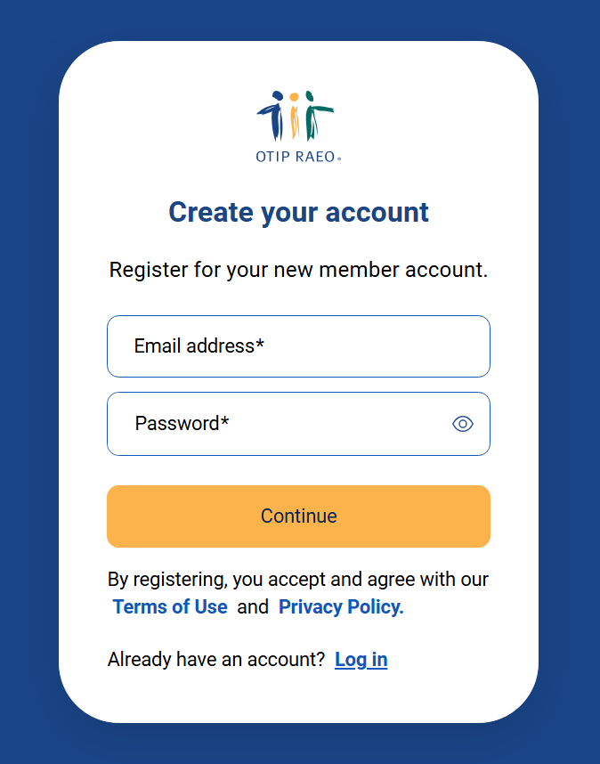
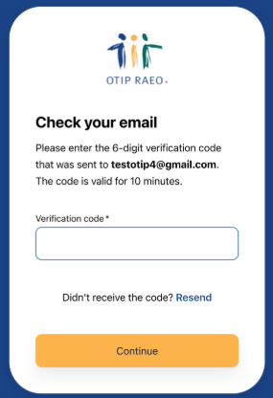
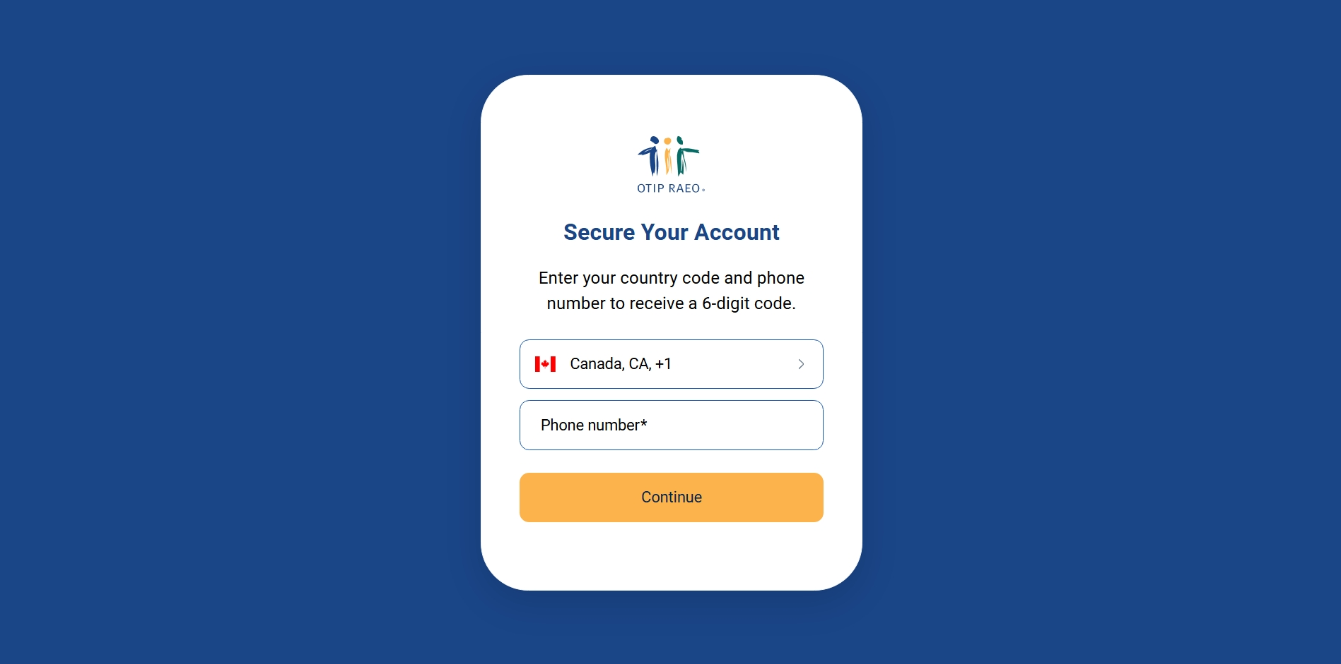
OSSTF ELHT Benefit Plans – How Does an Eligible Member Enrol or Make Coverage
Selections
To complete the enrolment process a member will need to login through their My Member Account at member.otip.com. New members will first need to register for a My Member Account
1.1 From member.otip.com, click Log in
1.2 When you log in for the first time, you will need to enter your preferred email address and create a password. Click Continue
1.3 A 4-digit verification code will be sent to your preferred email address for authentication purposes After entering this code, click Continue
1.4 Member enters their phone number to receive another verification code

Slide 14
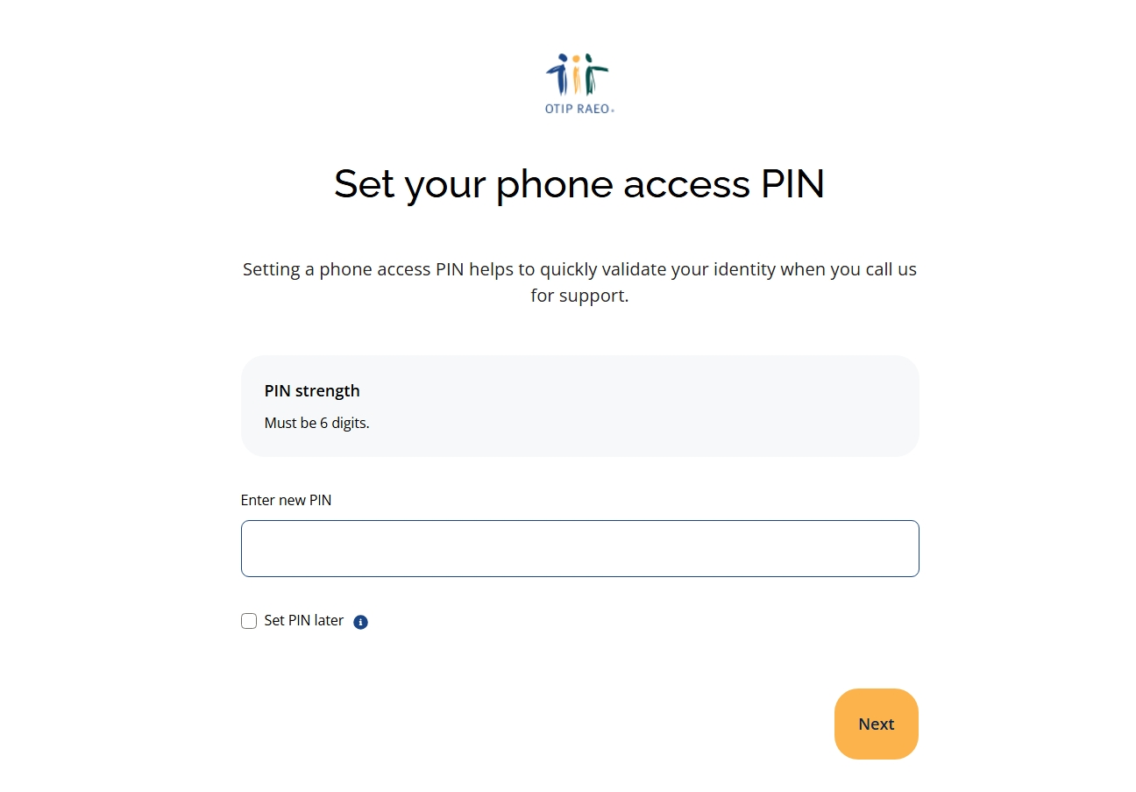
OSSTF ELHT Benefit Plans – How Does an Eligible Member Enrol or Make Coverage
Selections
1.5 Set your phone access PIN to validate your identity when calling OTIP for support (optional).
You can check “Set PIN later” to skip this step.
Click Next
1. To complete your registration, click Finish
Step 2: Start your enrolment
2.1 After logging into My Member Account, click on your Group Benefits plan.
2.2 Click Manage my benefits plan
2.3 Click Start under the New Hire/Newly Eligible event

Slide 15
OSSTF ELHT Benefit Plans – How Does an Eligible Member Enrol or Make Coverage
Selections
Step 3: Complete your enrolment
To enrol in your group benefits plan, you must complete the following steps in the New Hire/Newly Eligible event:
A. Family ( select single or family coverage- If family coverage is selected input details of eligible dependents)
In completing B and C members can select health and or dental coverage
B. Extended Health Care
C. Dental Care
D. Life & AD&D Insurance (Optional Life – Member, Spousal, Child (31 days for child cannot apply as a late
applicant)
E. Beneficiaries
F. Complete your enrolment
Enrolment help | OTIP RAEO

Slide 16
OSSTF ELHT Benefit Plans – How Does an Eligible Member Enrol or Make Coverage
Selections
After the initial enrolment opportunity members can:
Apply for new or additional member or spousal optional life benefits (not child optional life)
Reduce or terminate health and or dental coverage (e.g. change from family to single coverage, or fully terminate coverage)
The member CANNOT select new health or dental coverage without late applicant restrictions unless they experience a new life/work event

Slide 17
OSSTF ELHT Benefit Plans – How Does an Eligible Member Enrol or Make Coverage
Selections
Members have a new enrolment opportunity within 31 days of a Life/Work event to make new health and or dental coverage elections without restrictions
What is a Life/Work Event:
An increase in the Member’s FTE (e.g. going from a .67 to a 1.0 position)
A new LTO/LTA assignment of 90 calendar days or longer (not an extension of a current assignment)
A newly eligible dependent (marriage/common-law spouse, birth or adoption of a child)
Loss of Spousal coverage
Note: A spouse is defined as your legal spouse, or a person continuously living with you in a role like that of a marriage partner for at least 12 months

Slide 18
OSSTF ELHT Benefit Plans– How Does an Eligible Member Enrol or Make Coverage
Selections
An increase in the member’s FTE or a new LTO or LTA assignment (of 90 calendar days or longer) will be reported by the Board/School Authority to OTIP and the member will receive a new enrolment opportunity. If they apply for new health and or dental coverage within 31 days of receiving this enrolment event invite, they can make new selections without late applicant restrictions
For other events such as a newly eligible dependent or loss of spousal coverage, the change in coverage needs to be initiated by the member, as this will not be reflected in the data submitted to OTIP
The member has to make application within 31 days of the life/work event

Slide 19
OSSTF ELHT Benefit Plans – How Does an Eligible Member Enrol or Make Coverage
Selections
What if the member does not apply within 31 days of the initial enrolment opportunity or within 31 days of a life/work event?
As Basic Life and AD&D Benefits are mandatory for all eligible active members, no selections are necessary, so these benefits are not affected. However, for health and dental benefits, the member and/or dependents would be considered as late applicants and restrictions are applied
Late Applicant restrictions for Dental Benefits means that coverage is limited to $200 for the first 12 months of coverage
Late Applicant restrictions for Health Care Benefits, means that evidence of insurability (statement of health) must be submitted for approval. If approved coverage is effective the date of approval. Based on the assessment, coverage may be denied. The assessment is quite strict, and late applicant denials are not unusual

Slide 20
OSSTF ELHT Benefit Plans - Member Status Coding and Impact to Member Premium
Contributions
Member premium contributions are based on the member’s FTE and status( e.g. active or on leave) as reported by the Board/School Authority
For active members, member premium contributions for full-time members are 6% of the health and dental premiums, and are pro-rated for less than full-time members
Note: Member premium contributions are increasing September 1, 2026, and full details are outlined later in this presentation

Slide 21
OSSTF ELHT Benefit Plans - Member Status Coding and Impact to Member Premium
Contributions
For members who are on paid sick leave and statutory leaves (e.g. maternity/parental leave) member premium contributions remain the same as active (6% of health and dental premium for full time and pro-rated for less than full time)
For members on Long Term Disability Benefits, member premium contributions are the same as they were when active (6% of health and dental premium for full time and pro-rated for less than full time) for the first 24 months of their claim. After 24 months on LTD a member may elect to continue health and or dental benefits on a 100% member paid basis
For most other leaves including unpaid sick leave, extended parental leave, deferred salary leave, personal leave and laid-off members are eligible to continue with the benefit coverage they had while active during the leave on a 100% member paid basis. They can also choose to reduce coverage but are not eligible to increase their coverage. If a member suspends coverage during a non-statutory leave, they are not eligible to reinstate their benefits until their return to active duties in an eligible position

Slide 22
OSSTF ELHT Benefit Plans - Member Status Coding and Impact to Member Premium
Contributions
A Member’s eligibility to continue their benefit coverage also applies during a redundancy lay-off for:
up to a maximum of 24 months from the lay-off date for a member who is on a recall list, or
up to a maximum of 6 months from the lay-off date for a member who is indefinitely laid off and not on the recall list
Note:
This does not apply to summer lay-offs. Active permanent members who were eligible on the last day of scheduled work before the summer remain eligible during the summer at the same member premium contributions they were paying as active (unless they resign or retire). If a member is laid off on a date after the summer break with no active duties to return to in September, this would be the start date of their lay-off eligibility

Slide 23
OSSTF ELHT Benefit Plans – September 1, 2026 Plan Design Efficiencies and Member Premium Contribution Changes
Phase 3 Biosimilars – Directing claimants from an originator biologic to a biosimilar specialty drug (with appeal available) – 131 claimants
Phase 2 Preferred Generics – directing specific specialty drug claims to one of the generic options (lower cost but same efficacy) – 6 claimants
Phase 4 MemberRx Specialty Drugs – Move more claimants over to have their medications dispensed by MemberRx – 30 claimants
Reference Based Pricing on Proton Pump Inhibitors – Set coverage price at 2nd most competitive price level– 6,831 claimants
Basic Life Waiver of Premium – Transfer control of the reserve/liability from Manulife to OSSTF Benefits ELHT – no member impact
Member Share – Move the member premium share to the true 6% of health & dental benefit costs – all members

Slide 24
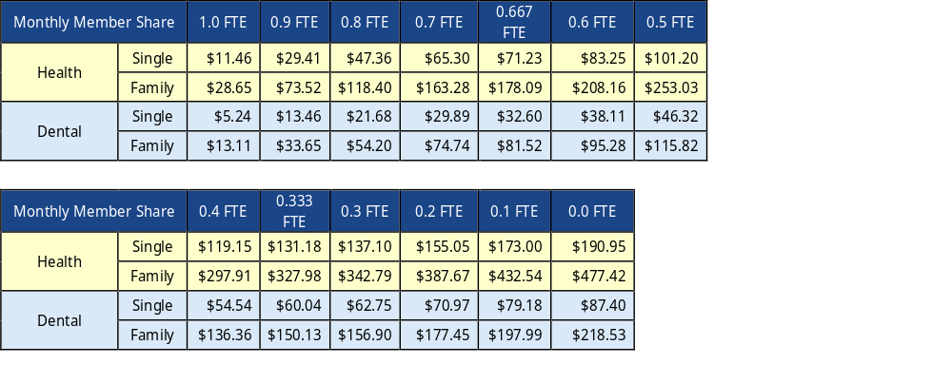
OSSTF ELHT Benefit Plans – September 1, 2026 Member Premium Contribution Changes
Eligible OSSTF Permanent Contract Teachers and LTOs

Slide 25
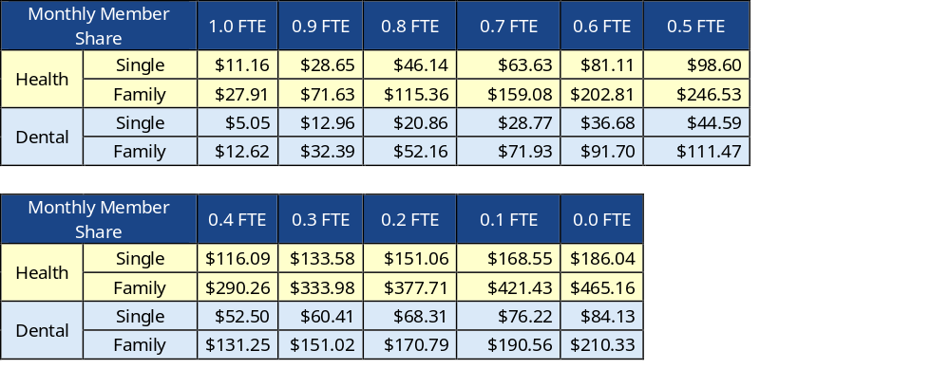
OSSTF ELHT Benefits Plans – September 1, 2026 Member Premium Contribution Changes
Eligible Permanent Contract Education Workers and LTAs

Slide 26
OSSTF ELHT Benefits Plans – September 1, 2026 Member Premium Contribution Changes
NOTE:
In the member premiums contributions charts 0.0 FTE applies to eligible permanent members on personal or unpaid leave, or Long Term Disability claimants who have an active LTD claim for 24 months or longer with an LTD benefit start date of September 1, 2026 or later. LTD claimants with an LTD benefit start date prior to September 1, 2026 are legacied at pre-September 1, 2026 member premium contributions. Health and dental member share is monthly and includes PST

Slide 27
OSSTF ELHT Benefits Plans – Resource Material Available to members
For more information visit the OSSTF ELHT Benefits website OSSTF Benefits
Benefits at a Glance OSST-ELHT-BAAG-Sept.-2026
FAQ section FAQs - OSSTF Benefits
Resource sectionF Benefits Resources Archive - OSSTF Benefits
News Section News - OSSTF Benefits News OSSTF Benefits
Also, through the OTIP login Login | OTIP RAEO members can access:
Login | OTIP RAEO
OTIP Help center includes FAQs on many topics Help centre | OTIP RAEO
OTIP News and Updates News and updates | OTIP RAEO

Slide 28
OSSTF ELHT Benefit Plans – Resource Material Available to Members
Need Help?
Details regarding plan design and coverage can be found in the benefits booklet which is available to members through their OTIP my Member account.
1). After logging in to My Member Account, click on your Group Benefits plan.
2). Click View my benefits booklet
Questions about coverage, enrolment, benefit selections or claims processing can also be directed to an OTIP Benefits Service Representative by calling 1-866-783-6847 or via chat or email through their OTIP My Member Account
Questions may also be submitted to comments@osstfbenefits.ca through the comment section of the OSSTF Benefits Website. Submitted questions are reviewed frequently and responded to by either the Director or Executive Director

Slide 29
OSSTF ELHT Benefit Plans – Resource Material Available to members
Need Help?
For assistance with more difficult benefit issues local leaders are invited to contact the OSSTF ELHT Benefits staff directly at:
Donna Morrison, Executive Director
Email: donna.morrison@osstfbenefits.ca
Phone: 519-501-6418
Or
Dayle Whittaker, Director
Email: dayle.whittaker@osstfbenefits
Phone: 519-766-7294

Slide 30
Questions

